Slide 1
Thermal transport & gas diffusion in CNT aerogels
Lin Hu, Scott N. Schiffres,
Jonathan A. Malen, and Alan J. H. McGaughey
Department of Mechanical Engineering
Carnegie Mellon University
February, 20th 2012

Slide 2
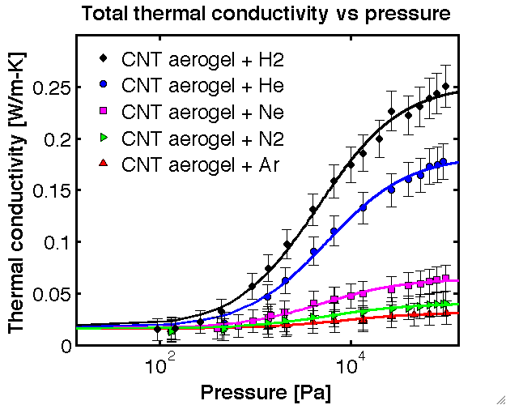
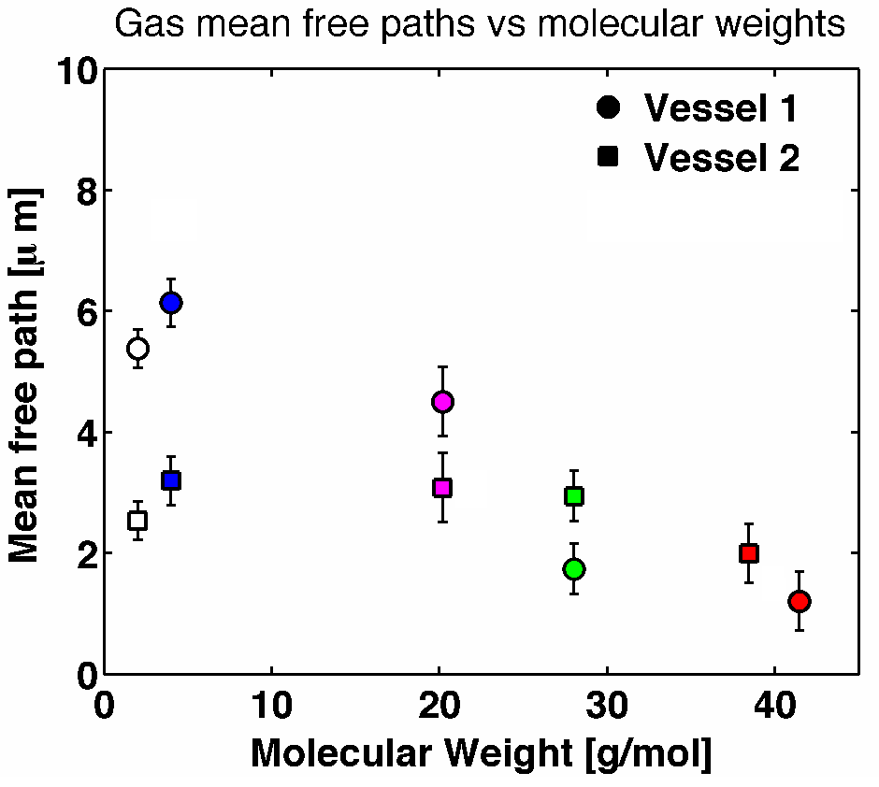
Background & Motivation
Gas mean free pass L_{KT} (2-7 um) >> Characteristic pore diameters d_{c} (2-50 nm)

Slide 3

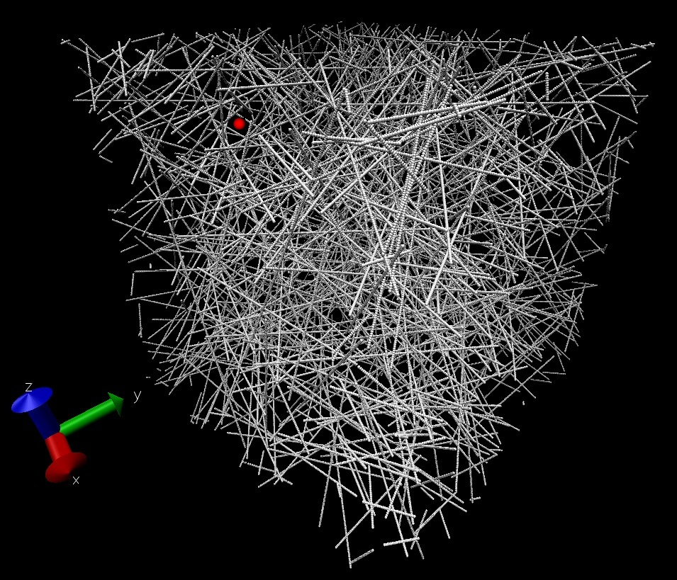
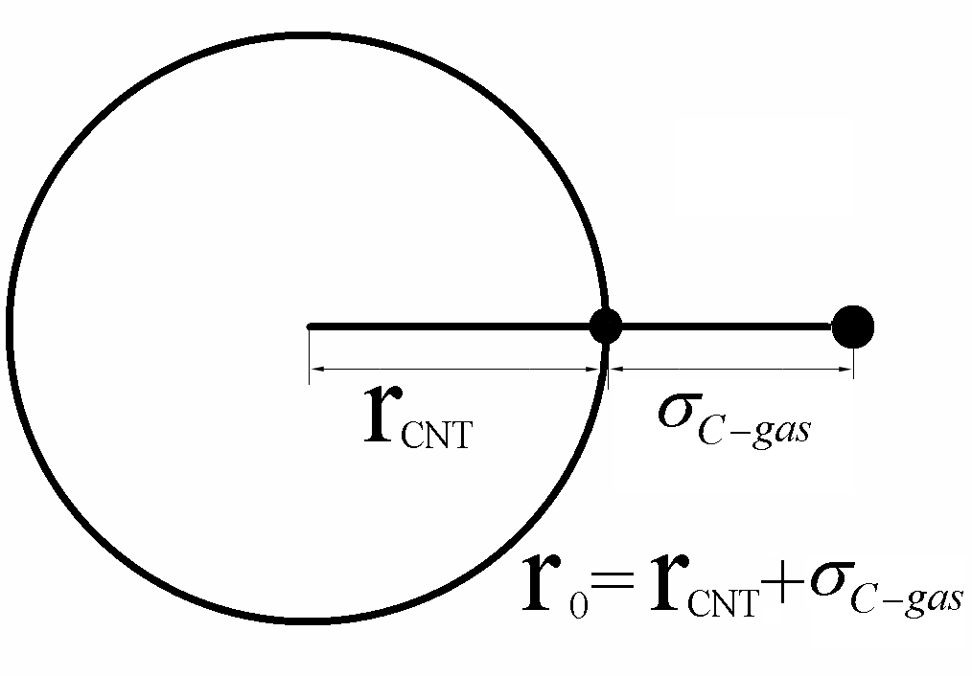
Estimation of gas traveling distance in CNT aerogels
Procedure
Randomly choose a starting point and direction
Move the gas atom 1A at the selected direction until collision happens
Record the traveling distance
Repeat the calculation 10,000 times
Calculate the average gas traveling distance r_{s}
r_{s}= L_{KT} or r_{s}= d_{c} ???

Slide 4
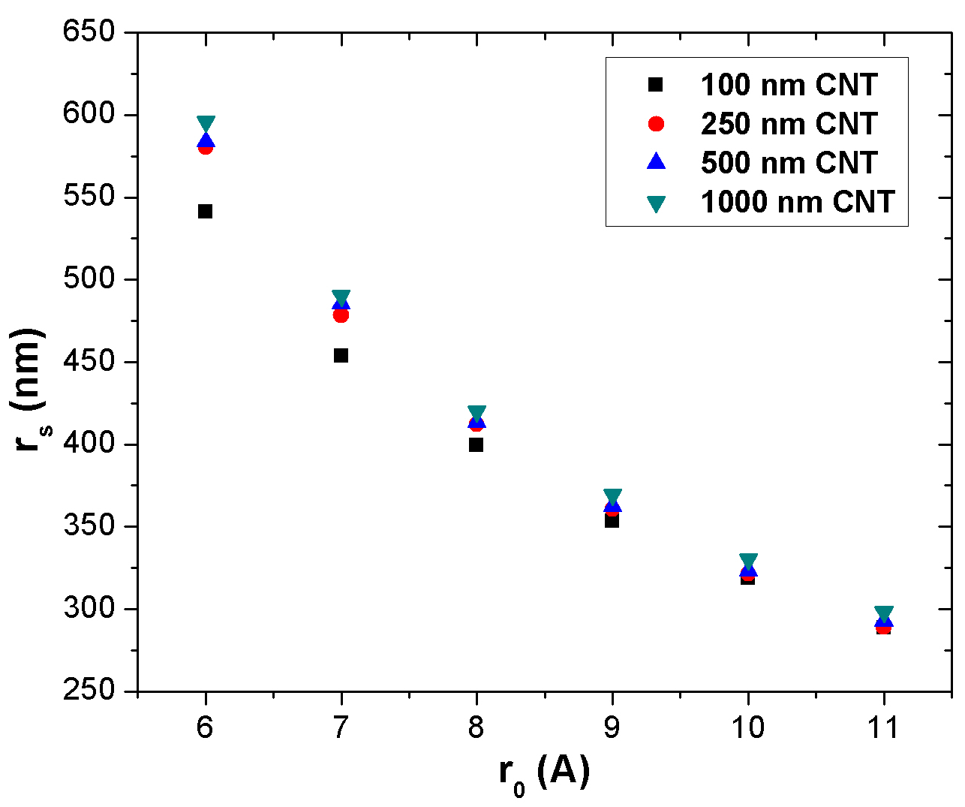
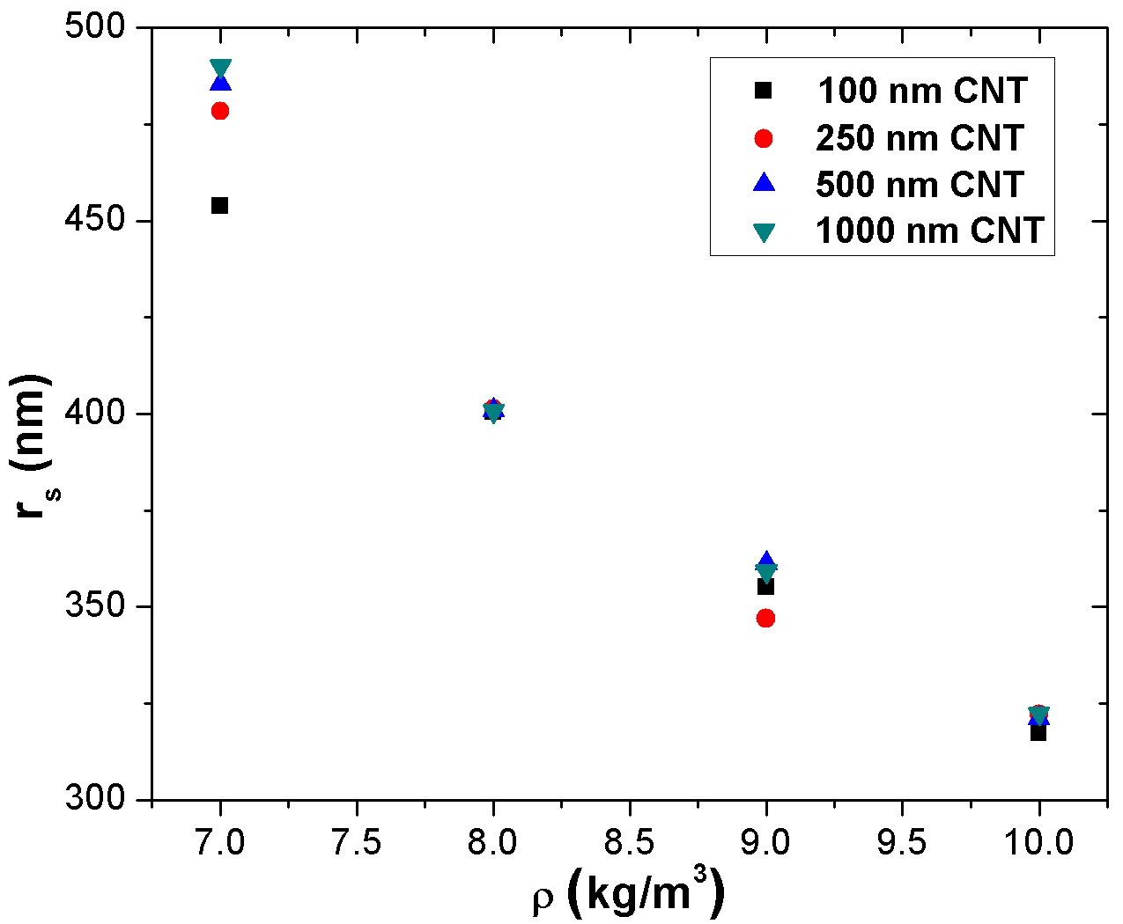
Estimation of gas traveling distance in CNT aerogels
Traveling distance of different gas (radius) in CNT aerogels with density of 7 kg/m³.
Traveling distance of Ne in CNT aerogels (different densities).
Ar (7.5A) – 450 nm Ne (7.2A) – 470 nm He (6.5A) – 520 nm

Slide 5
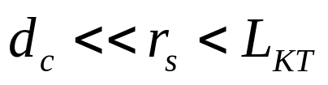
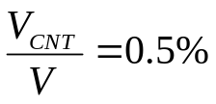
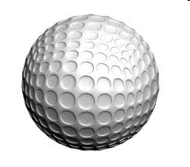

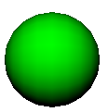

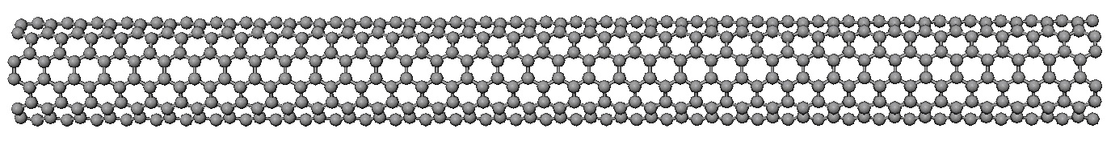
Experimental Measurements - Simulation
 | Ar | Ne | He
Experiment (L_{KT}) | 2.7 um | 5.6 um | 6.6 um
Calculation (r_{s}) | 450 nm | 470 nm | 520 nm
T_{in}
T_{re}
T_{CNT}
T_{re}= T_{CNT} ???

Slide 6
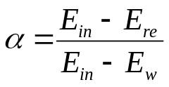

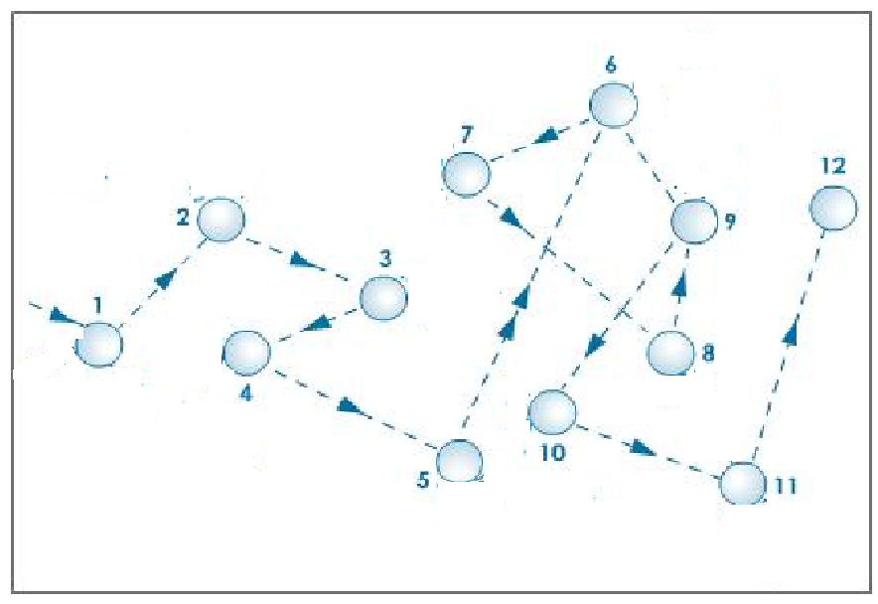





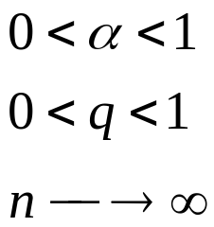
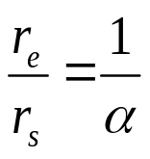
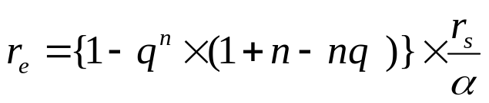
Experimental Measurements - Simulation
- thermal accommodation coefficient
- average gas traveling distance
- average energy traveling distance

Slide 7
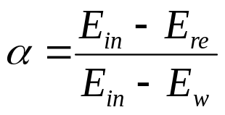
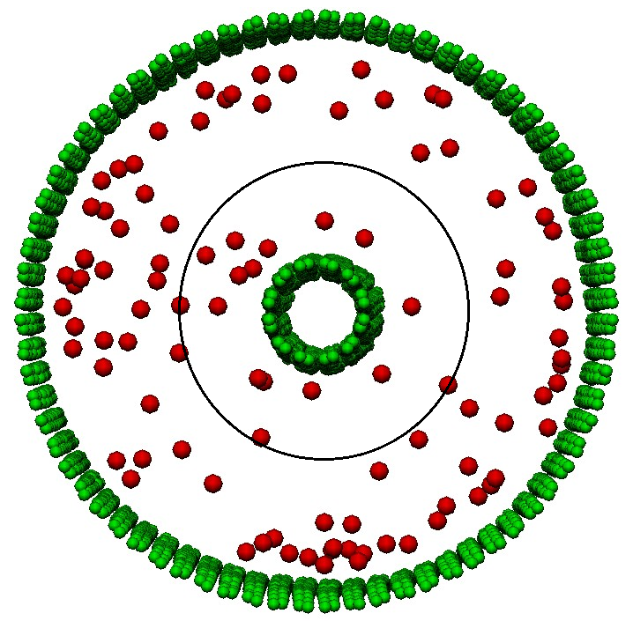
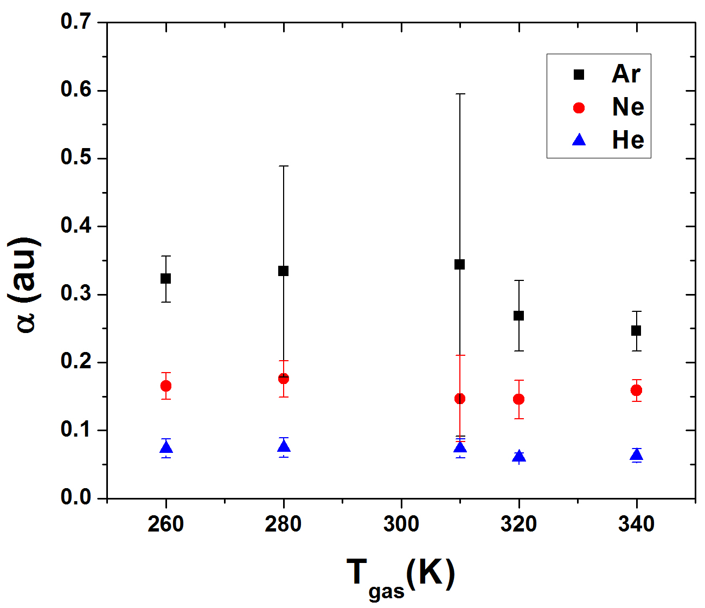
Thermal Accommodation Coefficient
T_{high}=320K
R₁=24 A
R₃=R₂+R_{cut}=13 A
T_{low}=300K
R₂=4 A
NEMD simulation
CNT – AIREBO CNT-gas – LJ potential
N1 gas atoms go into the cylinder
N2 gas atoms go out from the cylinder
Record velocities (energy) of gas atoms

Slide 8
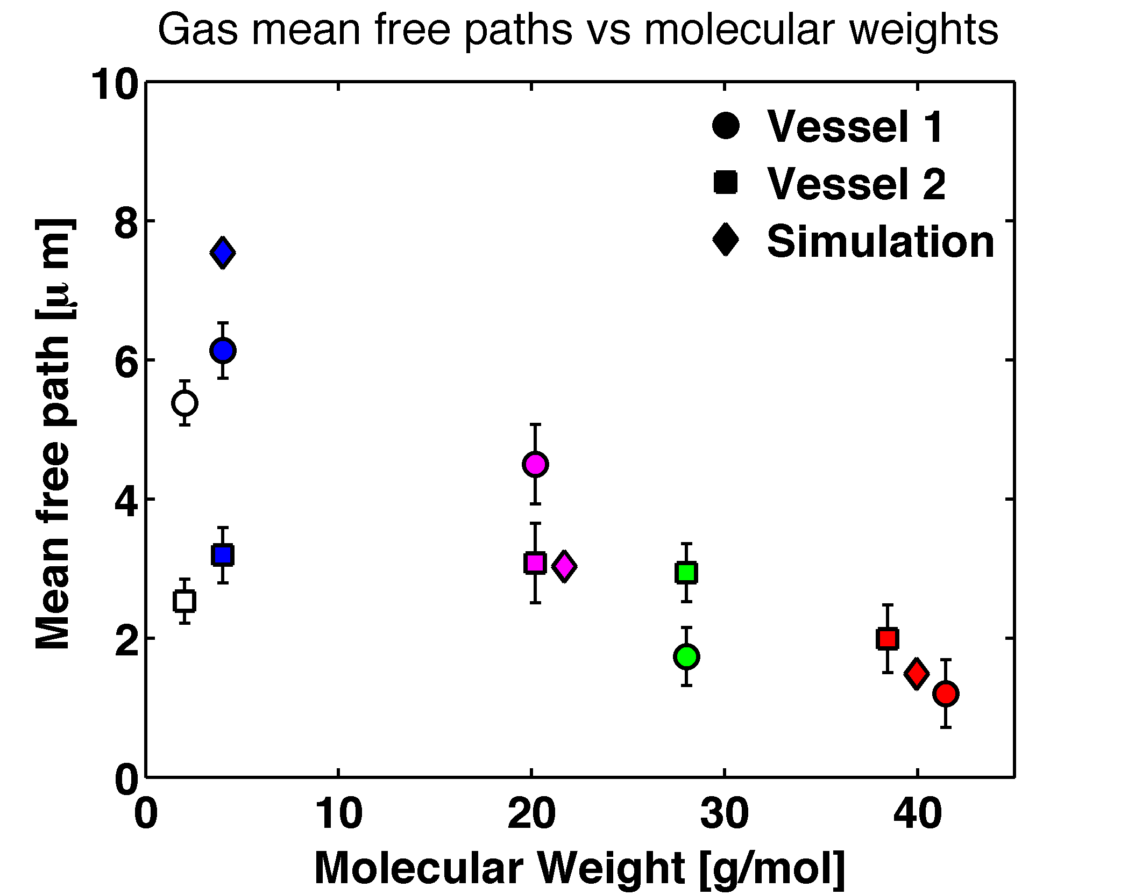
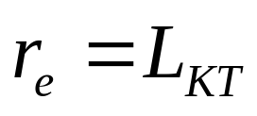
Experimental Measurements - Simulation
 | Ar | Ne | He
r_{s} | 450 nm | 470 nm | 520 nm
α | 0.303 | 0.158 | 0.069
 | Ar | Ne | He
r_{e} | 1.49um | 3.03um | 7.54um

Slide 9
Summary
Gas traveling distance in the CNT aerogel is calculated using the meso-scale CNT aerogel model.
Gas-CNT thermal accommodation coefficient is calculated with NEMD simulations.
Accommodation coefficient bridges the order-of-magnitude difference between the gas mean free path from experimental measurements and simulation.
Mechanism of gas diffusion in CNT aerogel is proposed.

Slide 10
Thank You !

